Slide 1
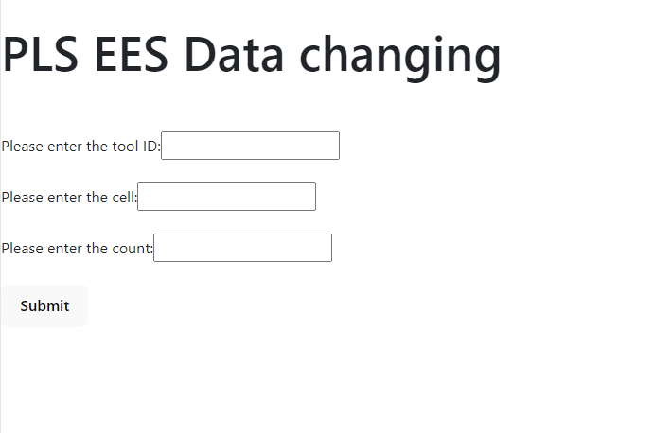
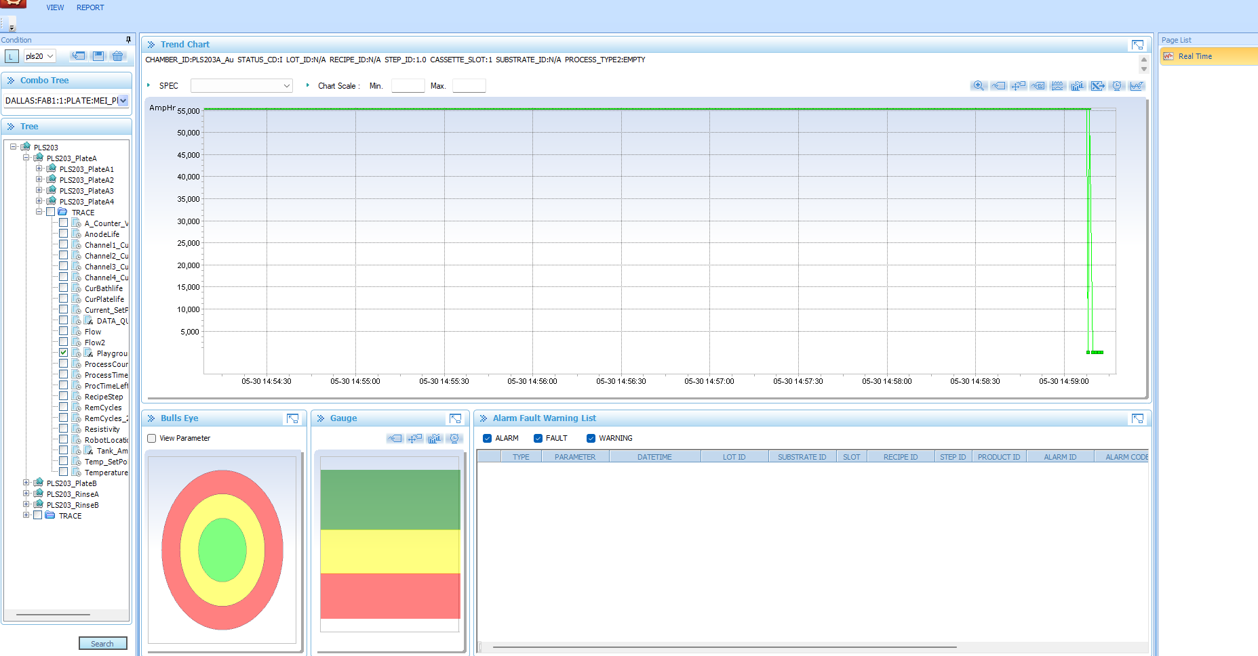
Eric’s Project (basically finished)
Got familiar with the EES software
Write an front-end interface for users
Wrote an server to connect EES backend

Slide 2
Next step
Update the host server for Qorvo with Andrew and his Intern
Show the work to Noah Brous later (4:00)
Verify the functionality with Eric once he is back
Connect more Chamber’s backend with my code and create an ecosystem

